Slide 1
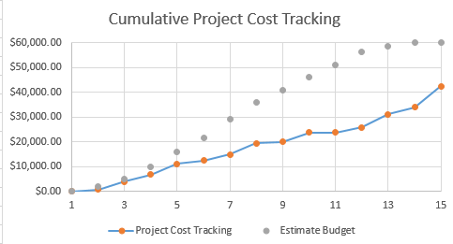
Project Cost

Slide 2
RECOMMENDATION AND CONCLUSION

Slide 3
RECOMMENDATION AND CONCLUSION
01
HTA and user guide to train workers with disability
Move setup to greenhouse to save electricity and maintain stable temperature
02
03
Time study research in the future
Stay in contact with Professor Nemali (the Hydroponics expert)
04
05
Utilize checklist tool to ensure successful lettuce growth
Continue hydroponics efforts and potentially explore expansion opportunities
06

Slide 4
WHAT WE LEARNED
Application of Technical skills and IE Coursework
Hierarchical Task Analysis – IE 486
Economic Feasibility Analysis (Net present value) – IE 343
Value Stream Mapping and Macro Tool – IE 332
Manufacturing principles – IE 370
Site Selection – IE 383
Values
Impact Industrial Engineers can make
Relationship with Janus

Slide 5

QUESTIONS

Slide 6
APPENDIX
6

Slide 7
VALUE STREAM MAPPING CALCULATIONS
Value Stream Mapping Calculations – Supplier Order Analysis
Supplier
Seeds per packet | 1000
Number of packets per order | 1
Total Number of seeds (Multiply result in row 6 by row 7) | 1000
Process
Maturity Period in weeks(Cycle Time) | 6
Seeds per cycle | 280
Total possible cycles with 4 packets | 4
Order Frequency
Weeks in a year | 52
Number of weeks seeds will last based on (Multiply result in row 10 by row 12) | 24
Ordering frequency per year(Divide result in row 17 by row 18) | 3

Slide 8
VALUE STREAM MAP CALCULATIONS
Value Stream Mapping Calculations – Crop Yield Analysis
Crop Yield
Crop Yield Analalysis
Yield per 10 foot horizontal row (in lbs) | 5
Total horizontal rows per level | 5
Number of levels | 4
Total number of rows (Multiply row 24 by row 25) | 20
Total yield per cycle (in lbs) (Multiple row 23 by row 26) | 100
Production Capacity of a single hydroponics system as Janus
Average weight of a bag of lettuce at a grocery store (in lbs) | 0.0625
Total capacity of the hydroponics system in bags (Divide row 24 by row 28) | 1600

Slide 9
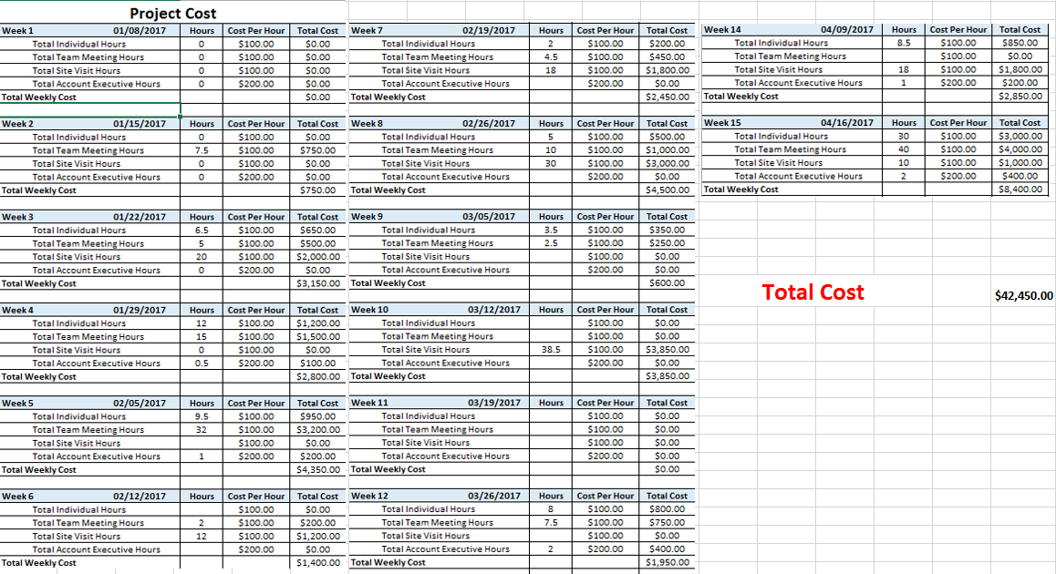
PROJECT COST

Slide 10
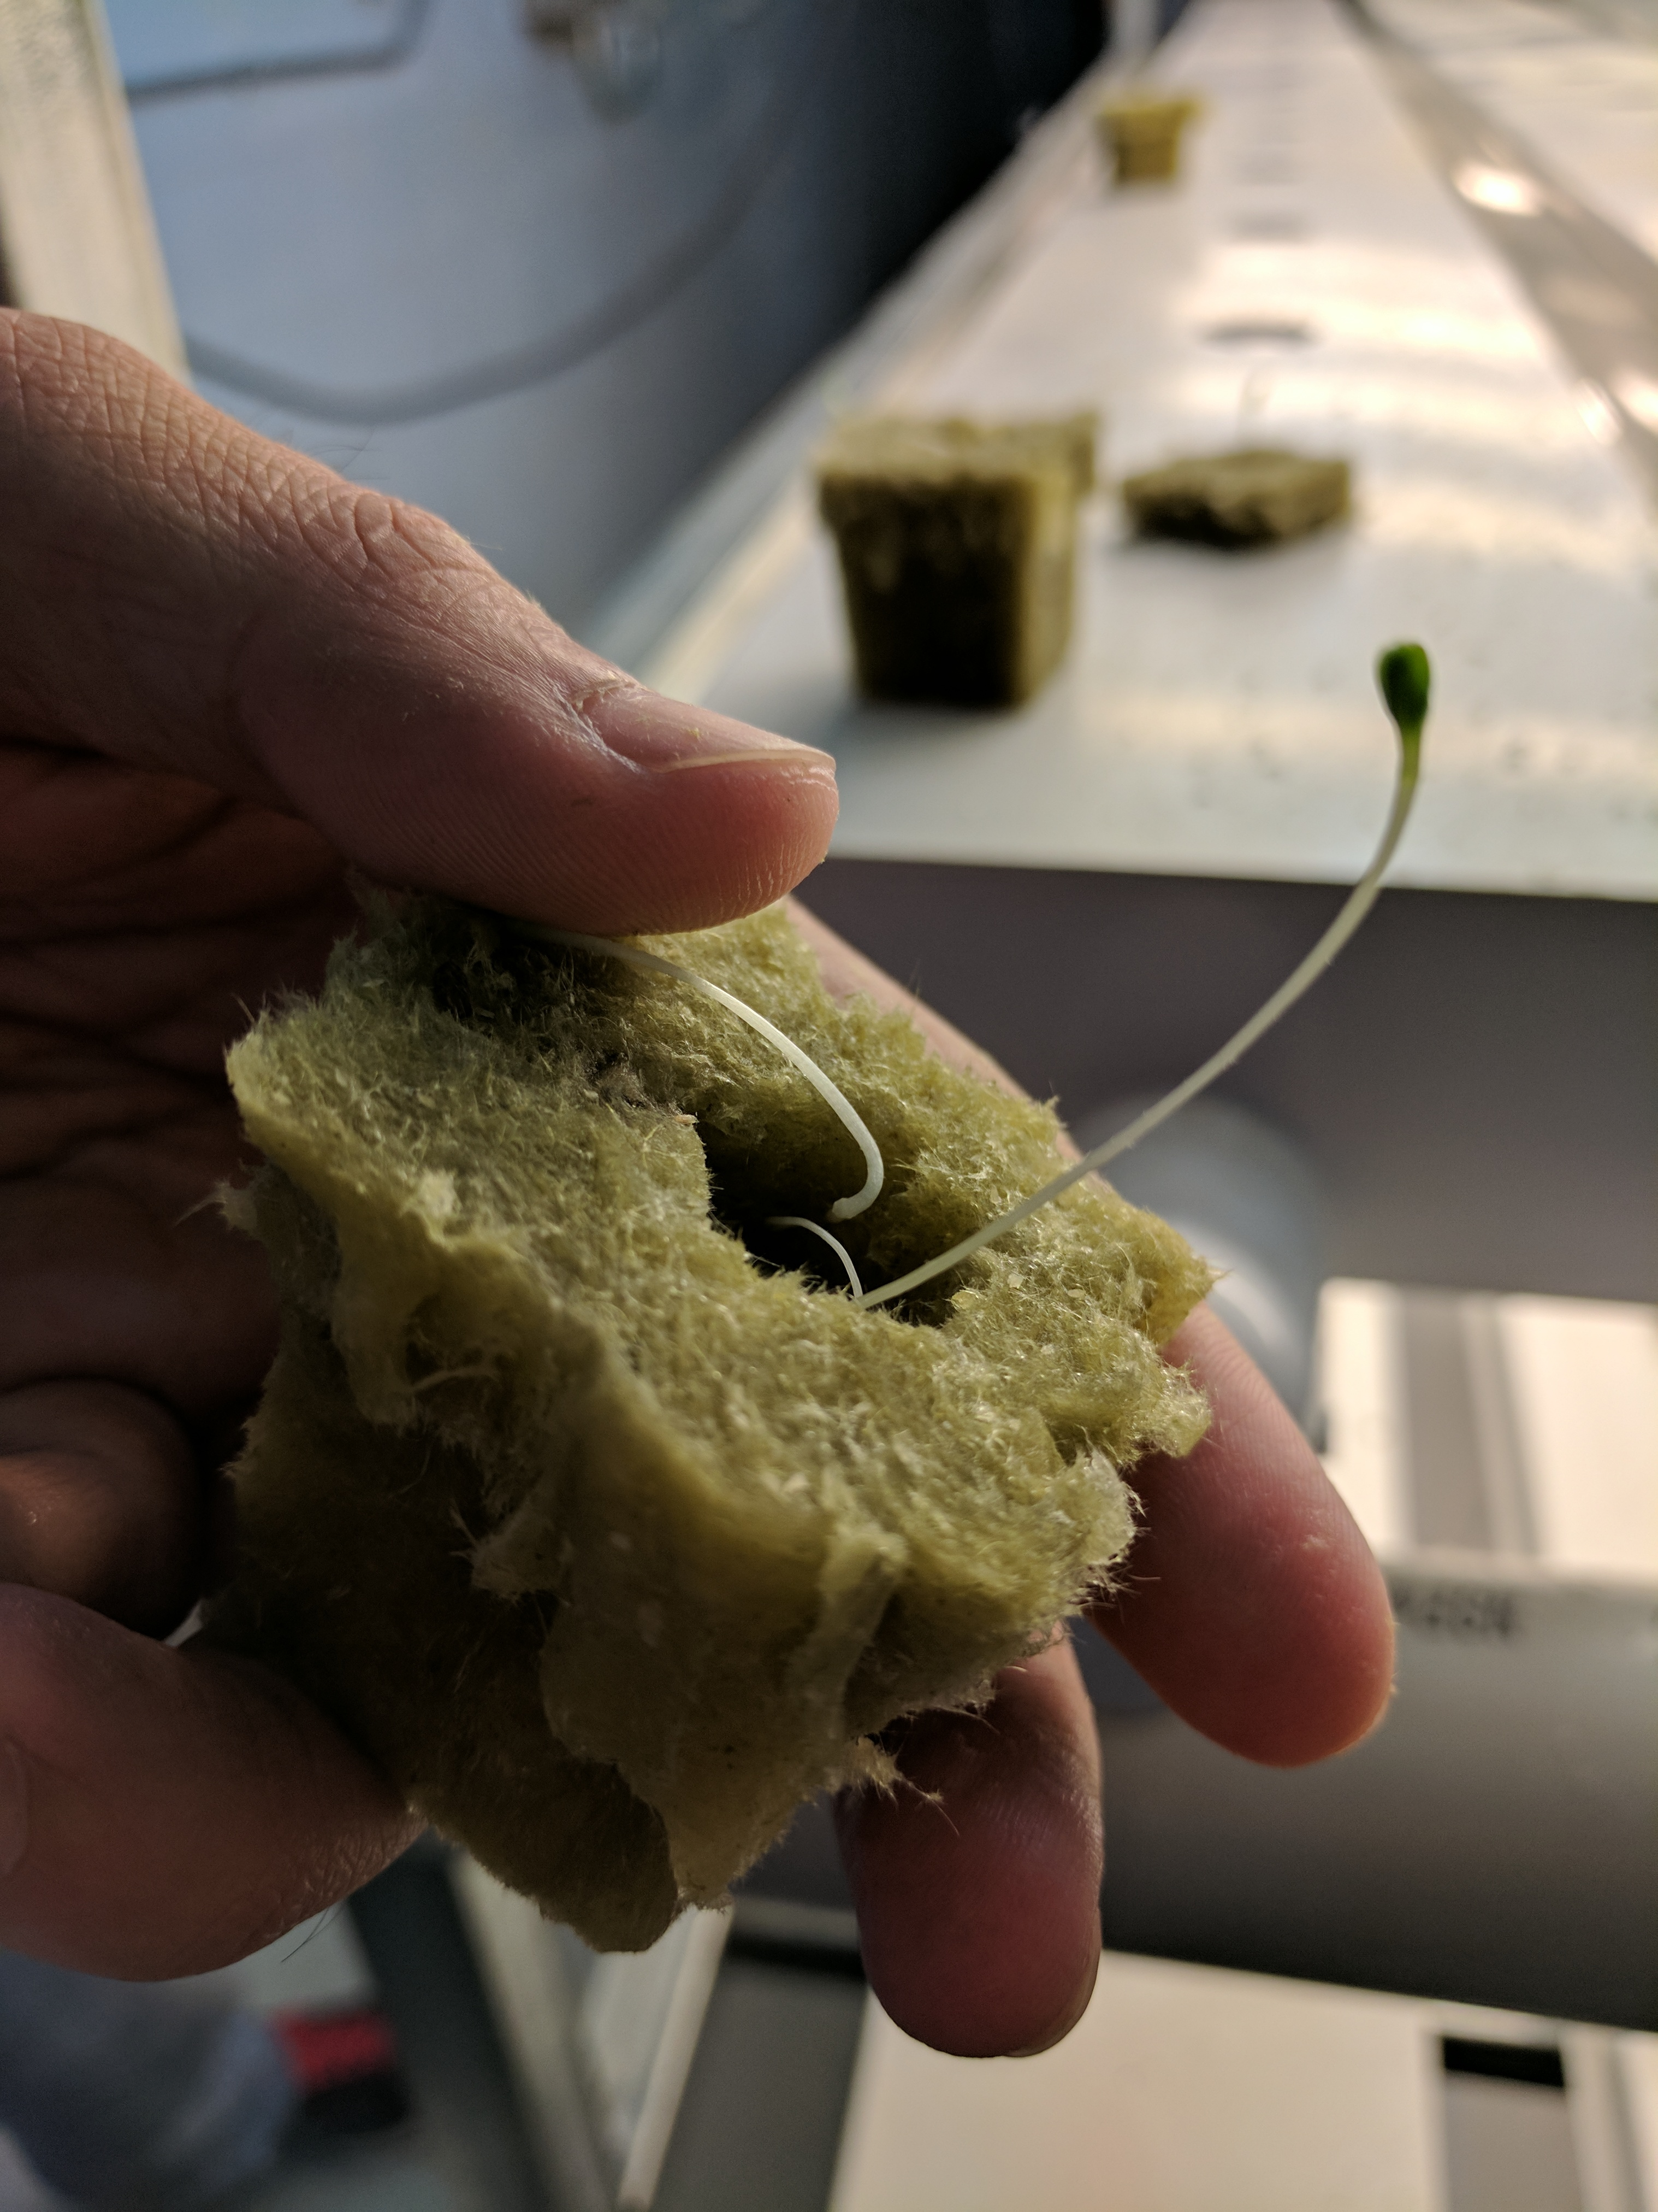
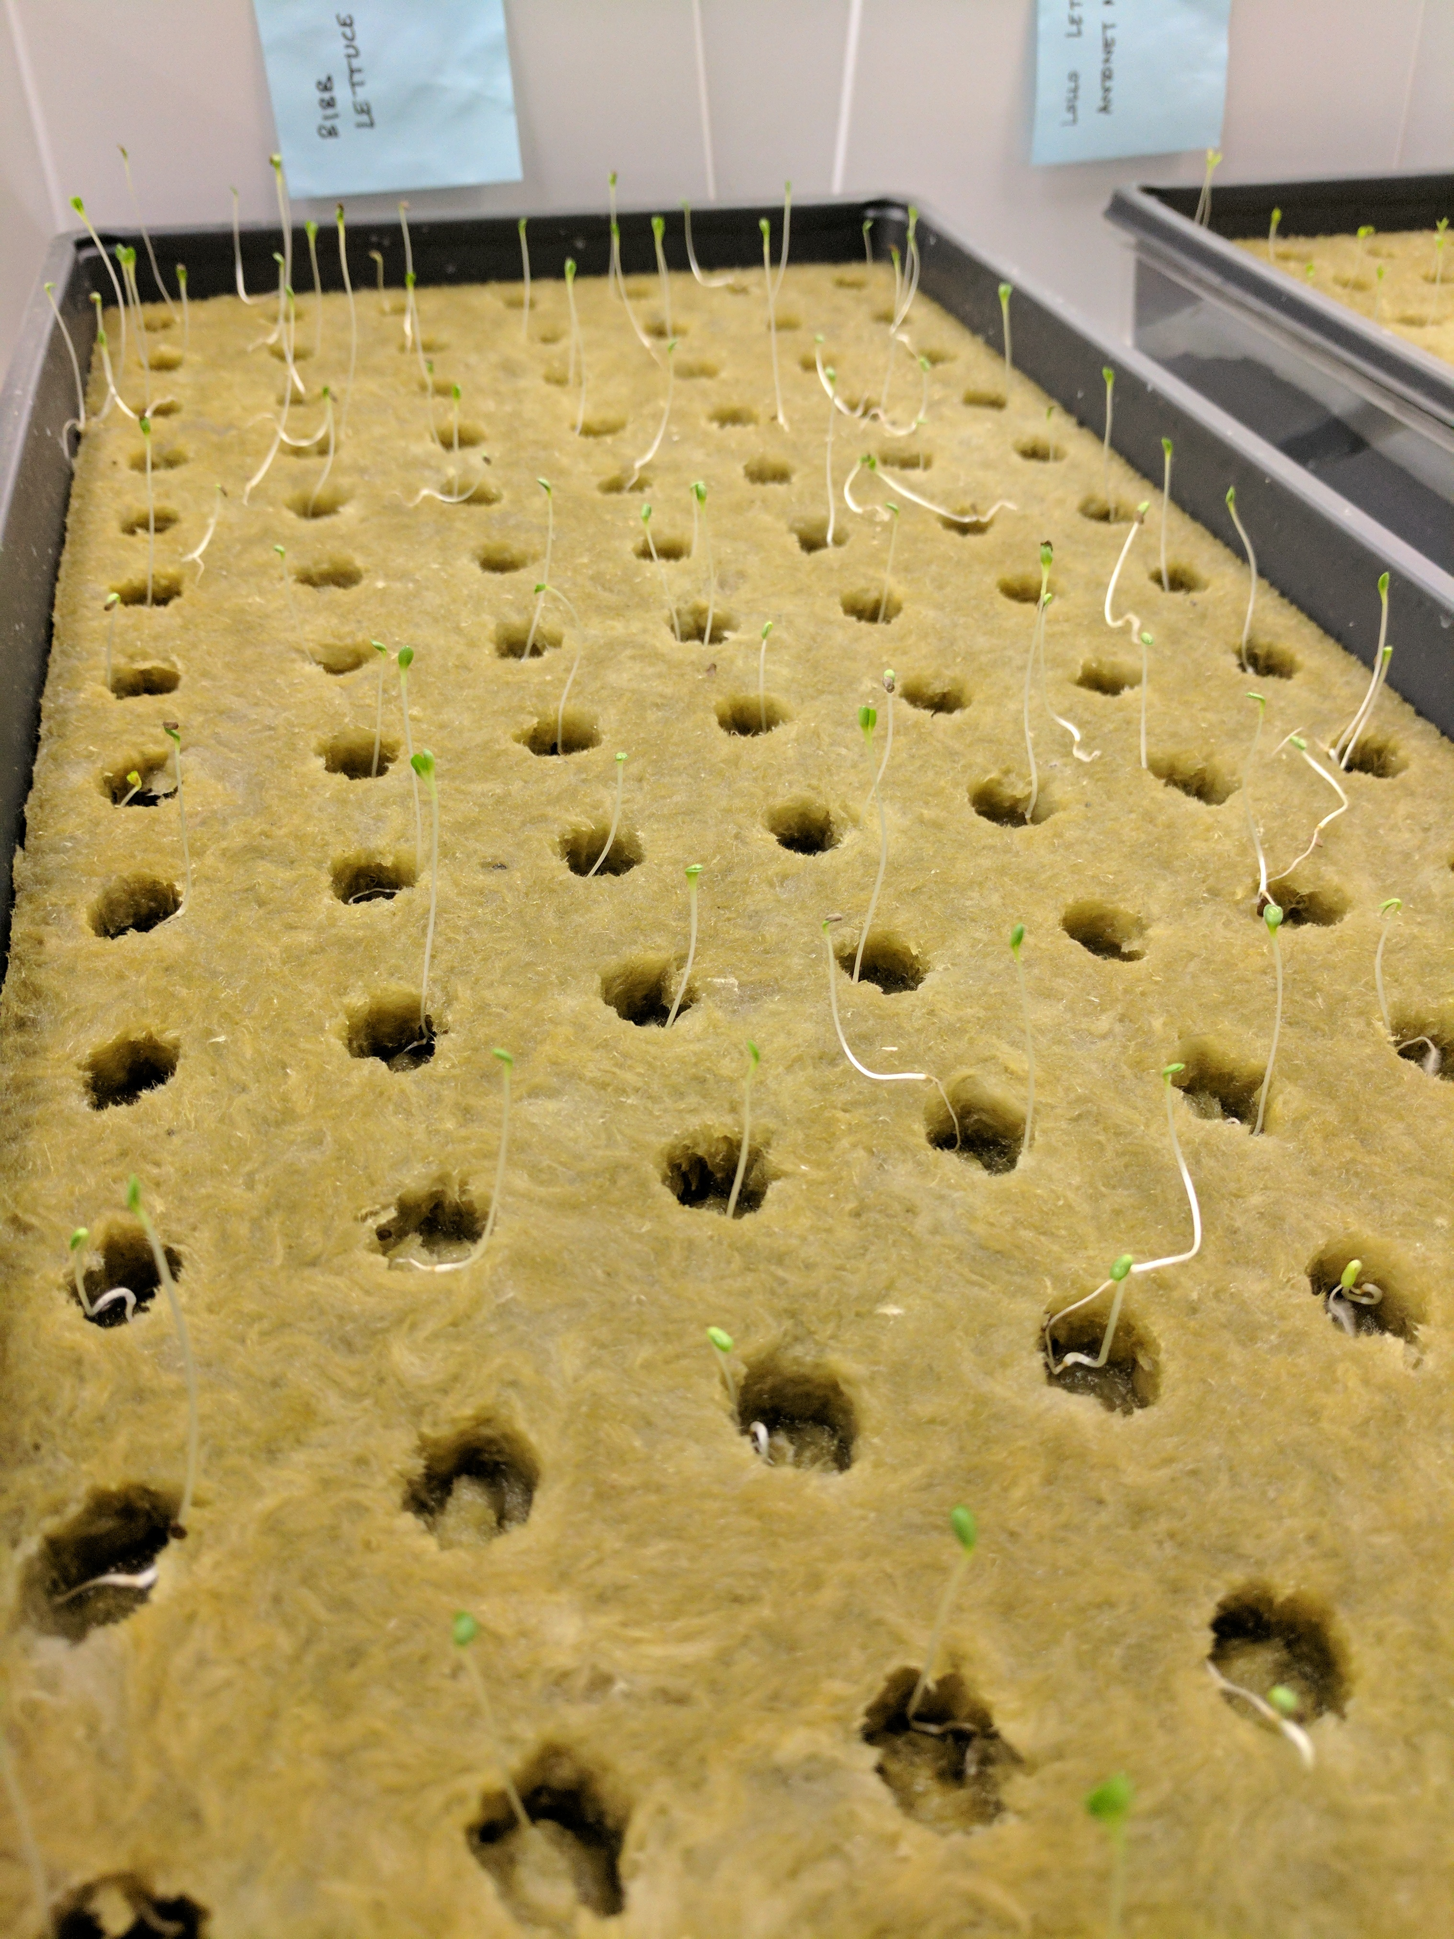
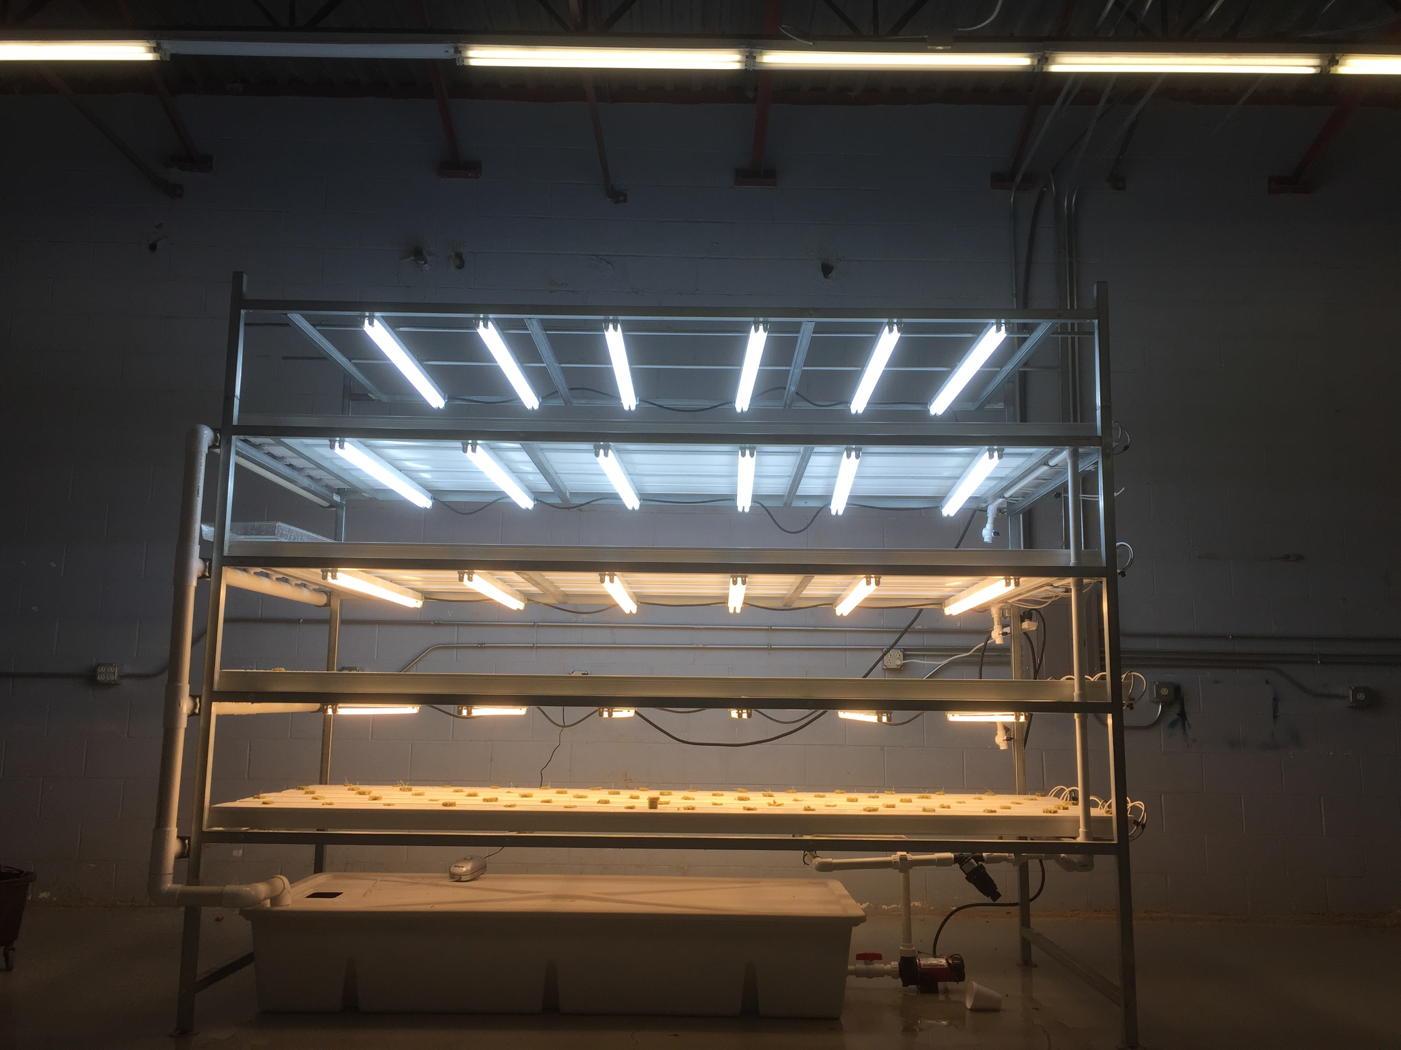
GERMINATION AND SETUP

